Slide 1
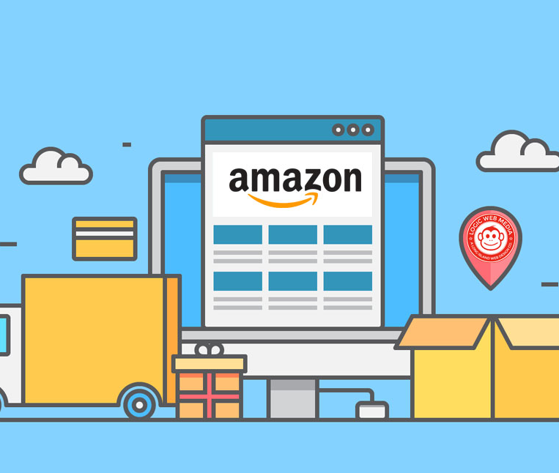
AMAZON SALES ANALYSIS
Submitted By: Tushar Gupta
Date :05-06-2025

Slide 2

AGENDA
Problem Statement
Data Descriptions
Key Metrics
Total Sales by Product Category
Unique Customers by Year
Total Sales by Product
Average of Wait times by Delivery Type
Revenue Distribution
Monthly Sales: Current Year vs Previous Year
Reports

Slide 3
Problem Statement
You are working as a business analyst at Amazon, a company currently performing well. The stakeholders wish to maintain this level of performance and seek improvement. For this purpose, they want to devise new strategies.
You are part of a team exploring new ways to benefit customers, such as offering more discounts and Prime membership perks. Could you suggest additional methods to identify and reward customers and enhance their shopping experience?

Slide 4
DATA DESCRIPTION
OrderDate: The date when the order was placed.
OrderID: A unique identifier for each order.
Delivery Date: The date when the order is scheduled to be delivered.
CustomerID: A unique identifier for each customer.
Customer Age: The age of the customer.
Customer Gender: The gender of the customer (M for male, F for female).
Location: The geographical area where the customer is located.
Zone: Specific zone within the location for delivery purposes.
Delivery Type: The method by which the order is delivered (e.g., Express, Standard).
Product Category: The broad category to which the product belongs.
SubCategory: A more specific classification within the product category.
Product: The name or description of the product ordered.
Unit Price: The price per unit of the product.
Shipping Fee: The fee charged for shipping the product.
Order Quantity: The quantity of the product ordered.
Sale Price: The total sale price of the order.
Status: Current status of the order (e.g., Delivered, Returned).
Reason: The reason for the return or an empty field if delivered.
Rating: Customer rating for the order on a scale (e.g., 1 to 5).

Slide 5







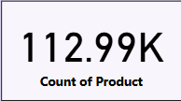

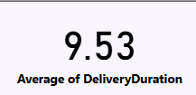
Key Metrics

Slide 6
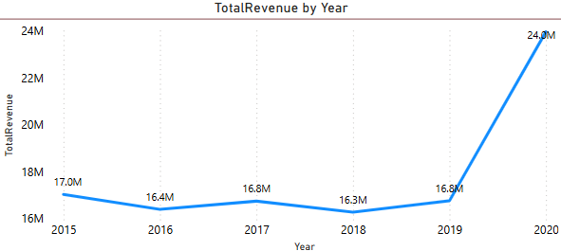
Total Revenue By Year
Revenue Fluctuations (2015-2019):
Total revenue remained relatively stable from 2015 to 2019, fluctuating slightly between 16.3M and 17M, showing no major growth.
Minor ups and downs (e.g., 2016 revenue dropped slightly to 16.4M, 2018 lowest at 16.3M).
2020 Revenue Surge to 24M (+42.8% Growth from 2019):
Massive jump in sales compared to previous years.
Indicates a major shift in consumer behavior or company strategy.

Slide 7
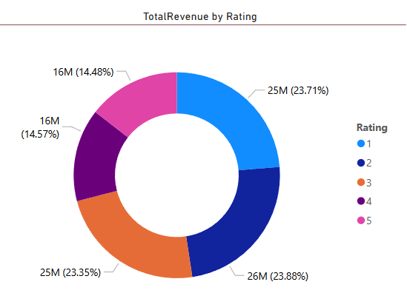
Total Revenue By Rating
Surprisingly, the highest revenue comes from low-rated products (ratings 1 & 2) rather than highly rated ones (4 & 5).
High revenue from poorly rated products suggests a need for quality improvement – Customers are buying but are not satisfied.
Lower revenue from top-rated products (4 & 5 ) might mean these products are priced higher or have less demand.
Identify & Improve Low-Rated , high-revenue products into high-rated ones to improve customer loyalty. Enhance quality, descriptions, and pricing.

Slide 8
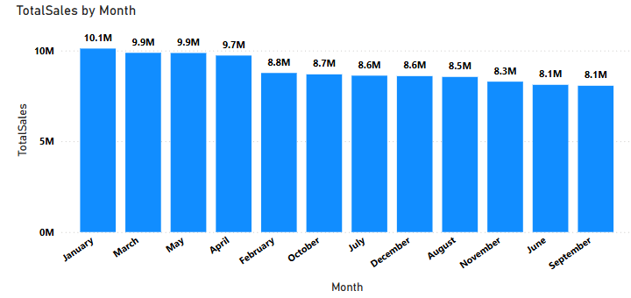
Total Sales By Month
January (10.1M) has the highest sales and doesn't require boosting.
June(8.1M), September(8.1M) and November(8.3M) represent sales dip below the average(9M) and should be targeted for enhanced promotions.
July, August, October, and December show consistent but lower-than-ideal sales that can benefit from specific seasonal promotions.

Slide 9
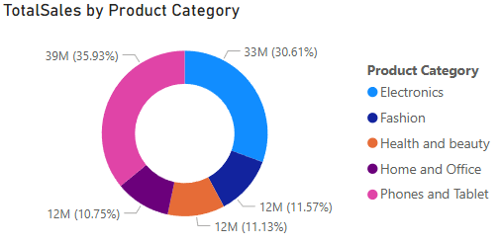
Total Sales By Product Category
Electronics(30.61%) and Phones & Tablet(35.93%) together contribute 66.54% of the total sales, making them the dominant categories. A well-executed marketing campaign focused on this category has the potential to drive additional sales growth.
Fashion(11.57%) and Health and beauty(11.13%) show moderate sales. Growth potential exists in these categories, which can be increased by introducing new products and executing focused campaigns. Offer discounts during major shopping seasons, Leverage video content to showcase product benefits, skincare routines, and beauty tips.
Home and Office(10.75%) products show lowest sales among the categories indicating reduced demand or lower visibility. Offer bundle deals, extra loyalty points , need better marketing and promotions.

Slide 10
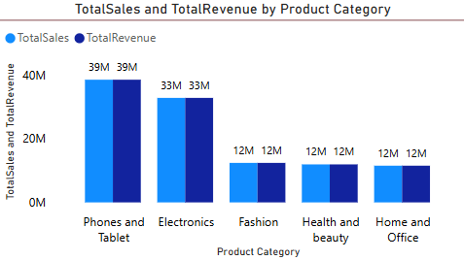
Total Sales And Total Revenue By Product Category
Phones & Tablets & Electronics dominate
total revenue, Amazon should continue promoting
these categories with exclusive deals.
Fashion, Home & Office, and Health & Beauty need
better marketing & engagement strategies to boost sales.
Health & Beauty has low revenue and low ratings,
suggesting a need for product quality improvements or
better branding.

Slide 11
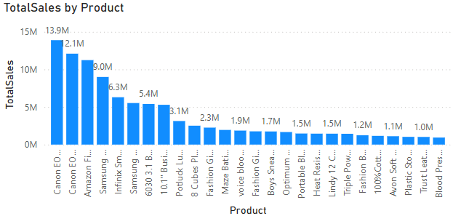
Total Sales by Product
The Canon EOS 600D and Canon EOS 60D DSLR cameras have recorded the highest sales figures, underscoring a strong demand for high-quality photography equipment.
The Amazon Fire HD 8 Kids Tablet and the Samsung Galaxy A02 smartphone have shown strong sales performance, indicating a high level of customer interest in budget-friendly and family-oriented technology.
Products with sales figures closer to the 1M or 2M mark may have a more niche audience but still hold substantial potential for growth. These products can benefit from enhanced visibility through data-driven marketing strategies, targeted advertisements, or strategic partnerships.
Implementing seasonal discounts, influencer collaborations, or product bundling strategies can help these products gain more traction in the market and drive overall revenue growth.

Slide 12
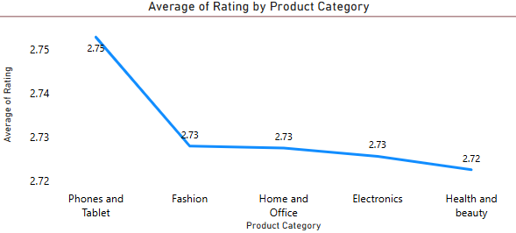
Average Rating By Product Category
No category has an exceptional rating, meaning Amazon should
focus on improving customer experience.
Phones & Tablets lead in ratings, indicating higher customer
satisfaction compared to other categories.
Health & Beauty scores lowest, Amazon may need to
reassess the quality or marketing of these products.

Slide 13
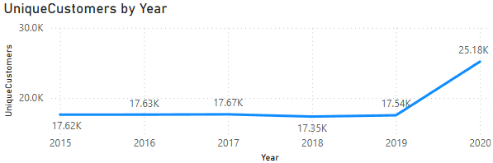
Unique Customers Per Year
Between the years 2015 and 2019, the number of unique customers exhibited a relatively stable trend, with fluctuations occurring within a narrow range. This consistency suggests that the business maintained a steady and loyal customer base throughout these years, with no significant spikes or drops in customer acquisition.
Notable shift occurred in 2020, as the number of unique customers experienced a significant surge, rising sharply .This marked increase suggests that the business successfully expanded its reach and attracted a substantial number of new customers within a short timeframe.
Several factors may have contributed to this growth, including targeted marketing campaigns, changes in consumer behavior, increased demand for specific products, or broader industry trends influencing purchasing decisions.

Slide 14
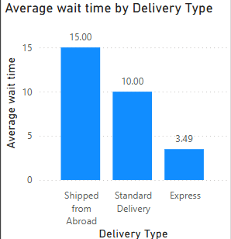
Average of Wait times by Delivery Type
The analysis of average wait times across different delivery methods reveals a strong correlation between the chosen shipping option and the time taken for customers to receive their orders.
Among the different delivery types, Shipped from Abroad has the longest average wait time of approximately 15 days, indicating that international shipping processes, customs clearance, and extended transit durations contribute to delays.
Implementing real-time tracking updates, estimated delivery timelines, and better communication regarding international shipments can help mitigate concerns.
Express Delivery stands out as the fastest option, with an average wait time of only 3.5 days. This highlights the efficiency of expedited logistics, prioritization of orders, and optimized supply chain processes to ensure quicker delivery

Slide 15
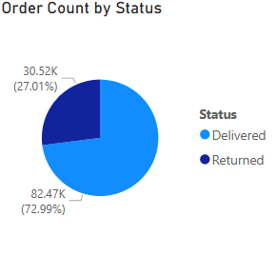
Total Order Count And Delivery Status
Delivered Orders: 82.47K (72.99%) – Majority of orders were successfully delivered.
Returned Orders: 30.52K (27.01%) – A significant portion of orders were returned.
Almost 1 in 4 orders is being returned, which is a high return rate, and it impacts revenue and logistics costs, reducing profitability.
Need to analyze which categories have the highest return rates and address the underlying causes.
Improving product listings, quality checks, and delivery experience can help lower returns.

Slide 16
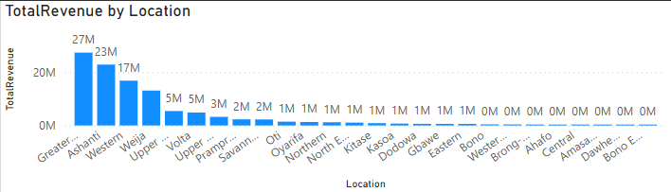
Revenue Distribution
Regions such as Greater Accra, Ashanti, and Western exhibit strong demand for products, making them crucial markets for business growth and strategic marketing efforts.
Regions like Prampram, Savannah, and North East present significant opportunities for market expansion. Although current sales levels may be lower, these regions hold potential for increased market penetration if businesses tailor their strategies to local consumer preferences, cultural influences, and economic conditions.
Regions such as Amasaman, Bono East, and Dawhenya exhibit lower sales volumes, which may be attributed to smaller populations, lower purchasing power, or limited commercial development. While these areas may not currently be strong revenue contributors, businesses can explore strategic interventions to improve sales performance.

Slide 17
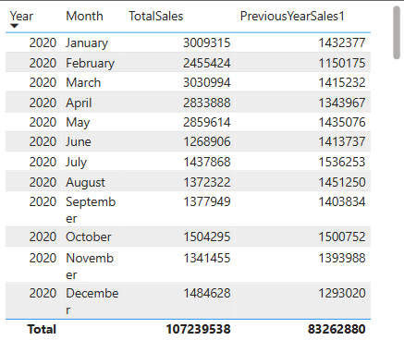
Monthly Sales: Current Year vs Previous Year
The initial months of 2020 witnessed a surge in sales, which may have been influenced by seasonal shopping trends, strategic product launches, or increased consumer interest in specific product categories.
February recorded a noticeable dip in sales, suggesting a period of lower consumer activity. This decline presents a valuable opportunity for businesses to implement targeted marketing strategies, such as Offering discounts, bundled deals, Enhancing customer engagement through social media and personalized recommendations to boost conversion rates.
Months like May and October demonstrated strong sales performance, indicating potential high-demand seasons. These months may correlate with festive periods, back-to-school shopping, or mid-year and holiday sales promotions, leading to increased consumer spending.
A closer examination of sales data highlights significant sales growth in July and March, which may be attributed to effective marketing efforts, product-specific promotions, or improved consumer sentiment.

Slide 18

Recommendations
1.) Market Segmentation Analysis: Targeted Marketing for Higher Conversion Rates
Customize marketing strategies to align with regional demands and cultural preferences.
Develop personalized advertising campaigns that resonate with different customer segments.
Optimize product offerings based on demographic insights to enhance sales performance.
2.) Reducing Waiting Time: Enhancing Customer Satisfaction and Delivery Efficiency
Streamline logistics and supply chain management to optimize shipping times.
Partner with multiple shipping providers to offer customers flexible delivery options.
Introduce express delivery services for high-demand products to enhance customer convenience.
3.) Regular Performance Evaluation: Continuous Improvement for Business Excellence
Evaluate customer complaints and suggestions to improve service quality.
Track key performance indicators (KPIs) such as average delivery time, order accuracy, and customer satisfaction ratings.
4.) Customer Loyalty Program: Driving Repeat Purchases and Long-Term Retention
Offer personalized discounts, reward points, and exclusive benefits to loyal customers.
Provide early access to new product launches, seasonal promotions, and premium services.
Encourage customer referrals through incentive-based referral programs.
5.) Promotional Strategy Optimization: Maximizing Sales Through Data-Driven Insights
Launch promotional campaigns around high-demand months to maximize revenue.
Offer discounts and limited-time offers during slow sales periods to attract customers.
Utilize social media and digital marketing to create buzz around key product categories.

Slide 19

Conclusion
Revenue Growth Over the Years - A significant increase in 2020 suggests business expansion, market trends, or pandemic-driven online shopping surge.
Impact of Ratings on Revenue - Surprisingly, low-rated products (1 & 2 stars) contribute the most revenue, highlighting the need to improve quality and customer satisfaction.
Sales Trends by Month & Product Category - Seasonal trends influence sales, with Phones & Tablets and Electronics being the top revenue generators, while Fashion, Home & Office and Health & Beauty require better marketing strategies.
Customer Growth & Engagement - Unique customers per year show steady growth, emphasizing customer retention strategies like loyalty programs & targeted discounts.
Delivery Performance & Customer Satisfaction - Order return rate is 27%, which is quite high. Fast delivery options improve customer experience but long wait times may affect ratings.
Revenue Distribution & Market Segmentation - Revenue distribution across locations can help optimize marketing efforts & logistics for better regional targeting.
Year-over-Year Monthly Sales Comparison - The company shows an upward trend, but some months see fluctuations, requiring strategic sales planning.

Slide 20
REPORTS

Slide 21
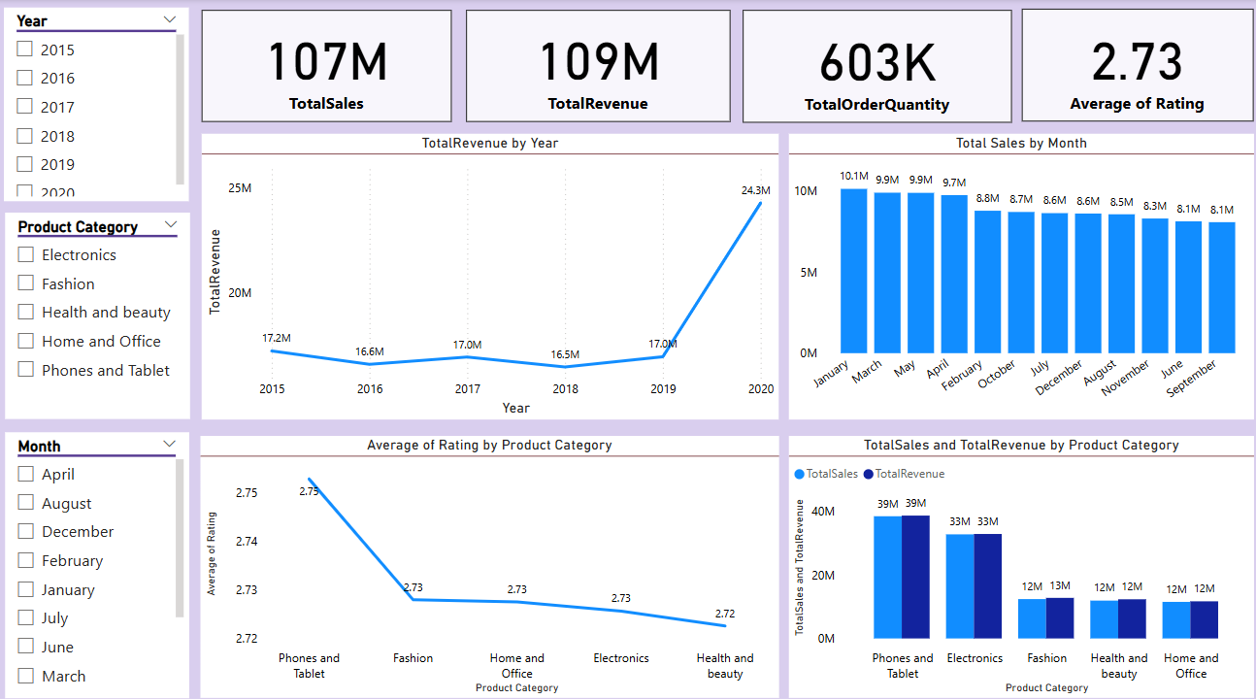
Amazon Sales Analysis

Slide 22
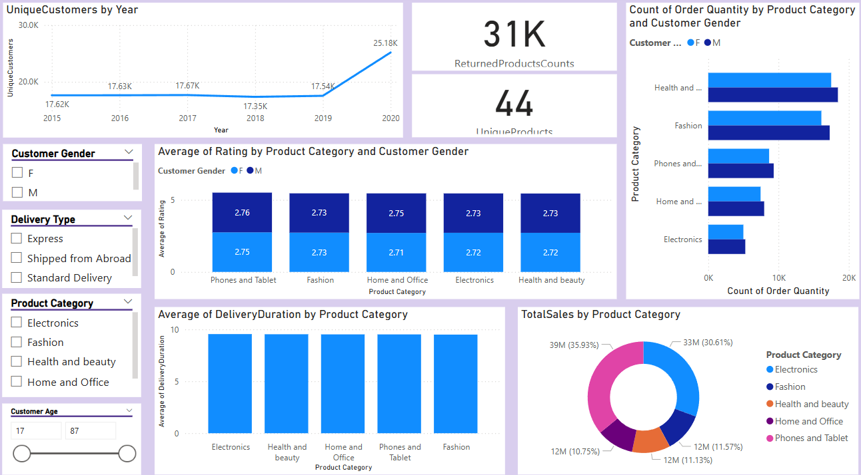
Product Category Analysis

Slide 23
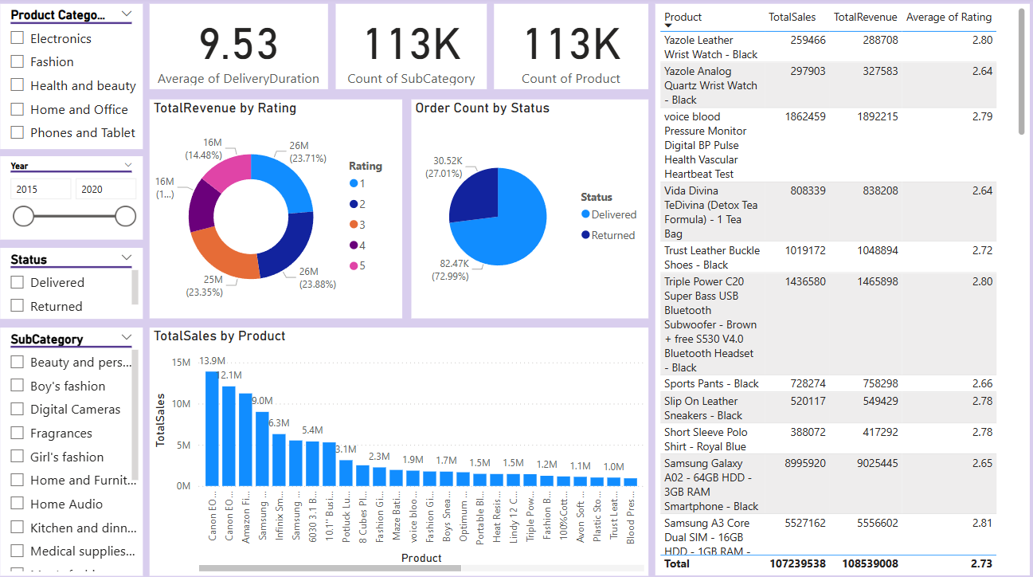
Individual Product Analysis

